Slide 1
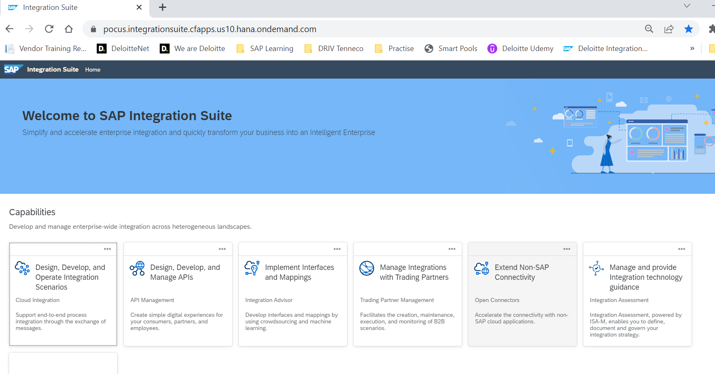
Integration Suite - CI Design and Configuration
WebUI
Customer uses tenant specific web-based application
Web application URL is provided by SAP together with the tenant details.
Enter URL (that includes tenant) in browser and you are ready for browsing, designing, configuration, monitoring of integration scenarios.

Slide 2
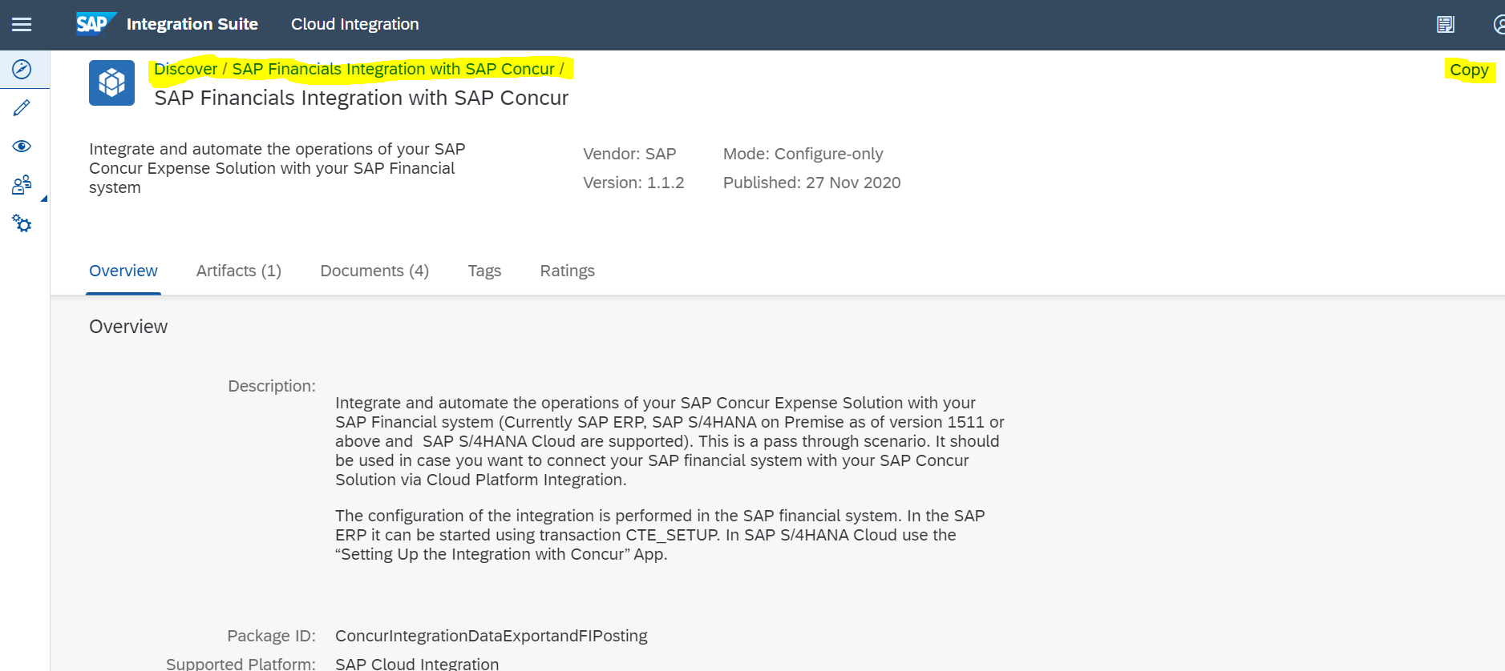
CI – Development Steps – Web UI
Configure and Deploy the iFlow using SAP Web UI
Connect to the tenant management node of the CI system to the url http://<tenant management node>/itspaces
Select the package that you want to implement and choose Copy

Slide 3
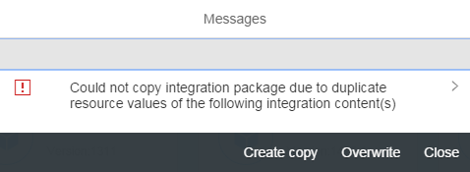
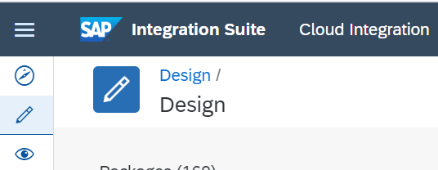
CI – Development Steps – Web UI
If the Integration package is being created first time, then you would see the message ‘Integration Package Created’. If not, you will see the below pop-up asking to either create a new copy of the package or to overwrite the existing integration package content.
4. Select the Design mode to configure the iFlows.

Slide 4
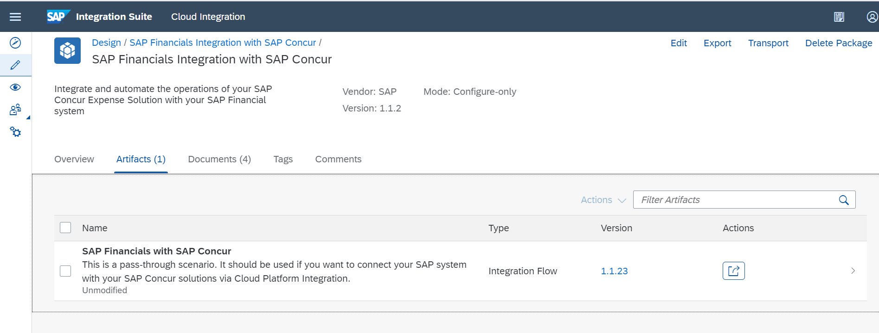
CI – Development Steps – Web UI
5. Select the Integration Package copied.
6. Click on Artifacts tab to list all the artifacts in the package

Slide 5
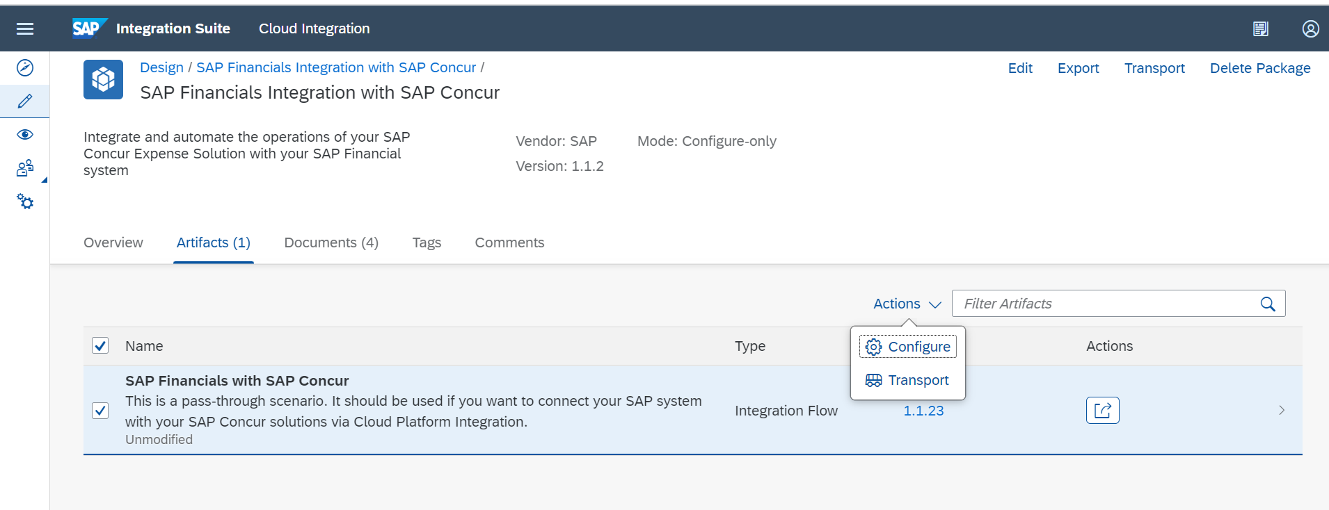
CI – Development Steps – Web UI
7. Select the iFlows you want to configure and choose Actions button in the right and select Configure.

Slide 6
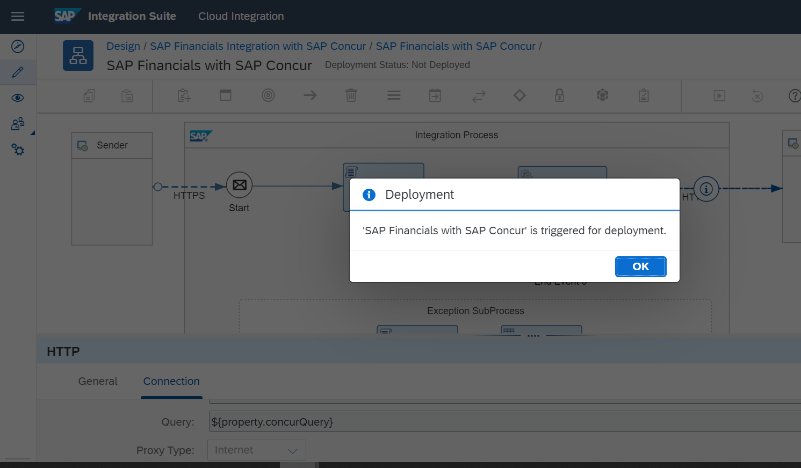
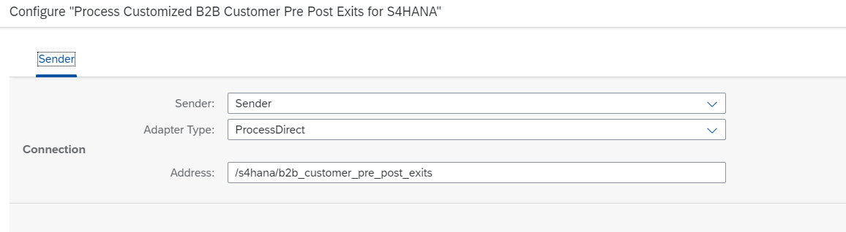
CI – Development Steps – Web UI
8. Configure details of the iflow based on the configuration options available and click on deploy

Slide 7
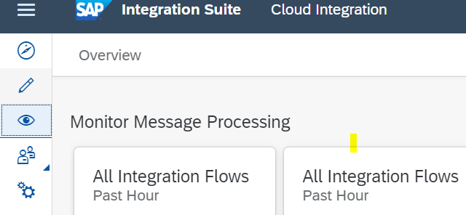
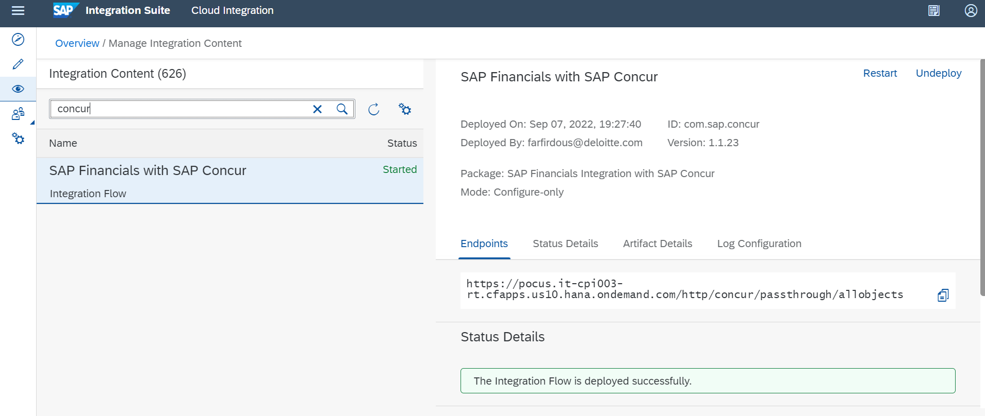
CI – Development Steps – Web UI
Go to ‘Monitor’ view and search for deployed Iflow.

Slide 8

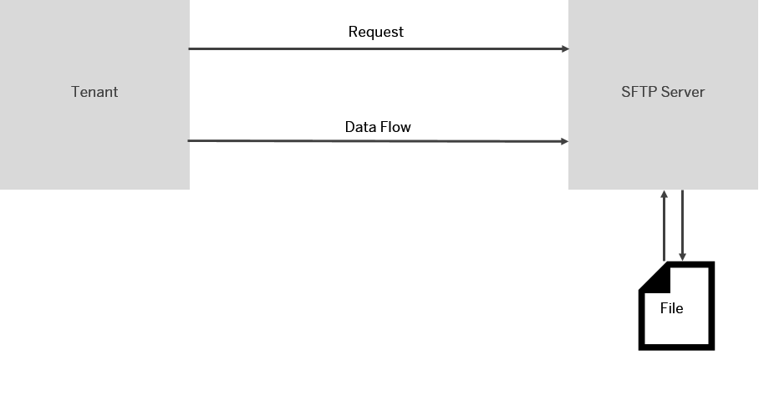
Adapters – SFTP
The SFTP Adapter connects an SAP Cloud Platform tenant to a remote system using the SSH File Transfer protocol to write files to the system.
The SFTP adapter uses a certificate and keystore to authenticate the file transfer unlike the standard FTP.
The SFTP adapter achieves secure transfer by encrypting sensitive information before transmitting it on the network.
It uses SSH protocol to transfer files.
This adapter does not support connections to FTP servers.
SFTP Sender Adapter
CPI tenant sends a request to an SFTP server, to read the file (called as polling).
File is sent to the CPI Tenant after which further processing is done
SFTP Receiver Adapter
CPI tenant sends a request to an SFTP server, to write the file
File is sent to SFTP server.

Slide 9
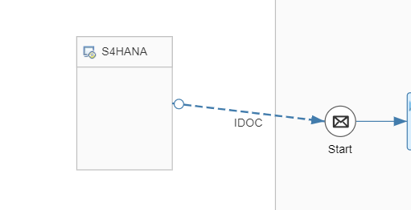
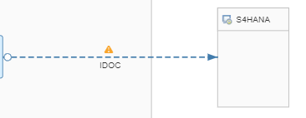
Adapters – IDOC
The IDoc adapter enables the SAP Cloud Platform tenant to exchange Intermediate Document (IDoc) messages with systems that support communication via SOAP Web services.
IDOC Sender Adapter
S4/ECC system send the IDOC messages to CPI tenant
CPI Tenant receives the IDOC message as an XML and processes it further
IDOC Receiver Adapter
CPI tenant converts the incoming message to IDOC xml structure
IDOC receiver Adapter is used to send the IDOC to S4/ECC System

Slide 10
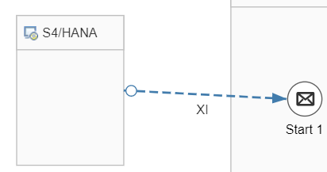
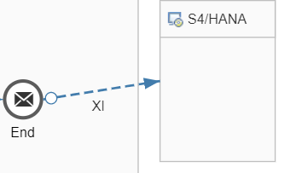
Adapters – XI
The XI adapter connects an SAP Cloud Platform tenant to a remote system that can process the XI message protocol.
The XI adapter communicates over the XI 3.0 protocol.
XI Sender Adapter
The XI sender adapter allows you to connect a tenant to a local Integration Engine in a sender system.
XI Receiver Adapter
The XI receiver adapter allows you to connect a tenant to a local Integration Engine in a receiver system.

Slide 11
Adapters – Success Factors
Three message protocols to communicate with the SuccessFactors system. SOAP OData V2 REST
Required details of SuccessFactors system –
Connection details – Details required to establish a connection with the SuccessFactors system. Processing details – Information required to process your modeled operation Scheduler – Settings that enable you to schedule a data polling cycle at regular intervals. The scheduler is available only for the sender channel.
Important Points –
- JVM contains the security certificate that is used by SuccessFactors system. - Ensure that the IP addresses of the CPI run-time worker node and the systems you are using to connect to the SuccessFactors system are in the list of allowed IP addresses. - You can use the Insert (POST) operation to insert more than one records in a single operation. These records must have an edmx association between them.

Slide 12
Adapters – Ariba
Ariba adapter enables the SAP and non-SAP cloud applications to send and receive business-specific documents (like PO, Invoice) in cXML format to and from the Ariba Network.
Required details of Ariba Network –
Connection details – Details required to establish a connection with Ariba Network Processing details – Information like cXML version, agent Scheduler – Settings for schedule a data polling cycle at regular intervals.
Important Points –
Certificate from Ariba or a trusted third party must be installed.
User Credentials and KeyStore must be deployed.
Use headers and properties to set values for Ariba Network URL, Credential Name, Private Key Alias and Ariba Network ID. ${header.url}, ${property.credentialName}

Slide 13
Adapters – OData
It enables to connect to systems exposing OData services (OData service providers). The connector allows to perform the operations Query (GET), Update (PUT), Create (POST), Merge (MERGE) and Read (GET), allowing you to query, update and insert of data.
Only receiver channel can be configured.
For batch processing for PUT and POST operations, the payload format sent to OData service must be in the recommended structure. Use input XSD with a mapping step to transform the payload into the recommended XSD structure or use XSLT or content modifier to do this.
While performing Insert (POST) operation, a reference can be added to an associated entity. Need to map the appropriate field from the payload to the key field of associated entity in <link> tag.
While using client certificate, EDMX file from the OData service provider are required and should be imported in src.main.resources.edmx folder. It enables to use local EDMX file to connect to the system.

Slide 14
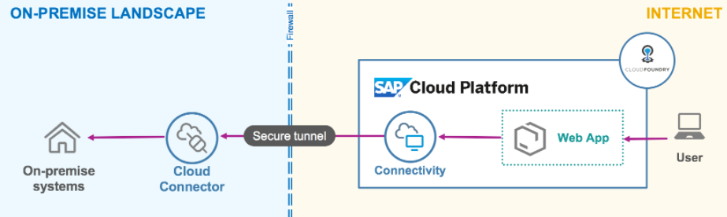
SAP Cloud Connector and CI Adapters
SAP Cloud Platform Connector (SCC) can be used with CI adapters to communicate with SAP on premise systems.
You have to install cloud connector on the on premise system/s that you want to communicate with, and configure it. This is a one-time activity after which you can use cloud connector with CI adapters.
Perform the following steps to use cloud connector with CI adapters.
Install SAP Cloud Connector on your on premise system.
Set up mutual authentication between the cloud connector and a backend system.
Enable the web application to connect to access backend system on the intranet.
It will enable you to connect to on premise systems using CI adapters by selecting on-premise value in Proxy Type field dropdown list.

